Slide 1




Bristol Poverty Institute
University of Bristol
bristol.ac.uk/poverty-institute
@bristolpoverty

Slide 2


Housekeeping
No fire alarm tests this afternoon
In the event of a fire, please leave via the signed fire exits
Assembly point 11, located in the 8 Priory Road carpark just across the road
Toilets are located just to the left of the entrance to this lecture theatre
We are live-streaming and recording this event and may also take some photographs.
These will be shared online including our website, social media, blog and/or newsletter.
bristol.ac.uk/poverty-institute
@bristolpoverty

Slide 3
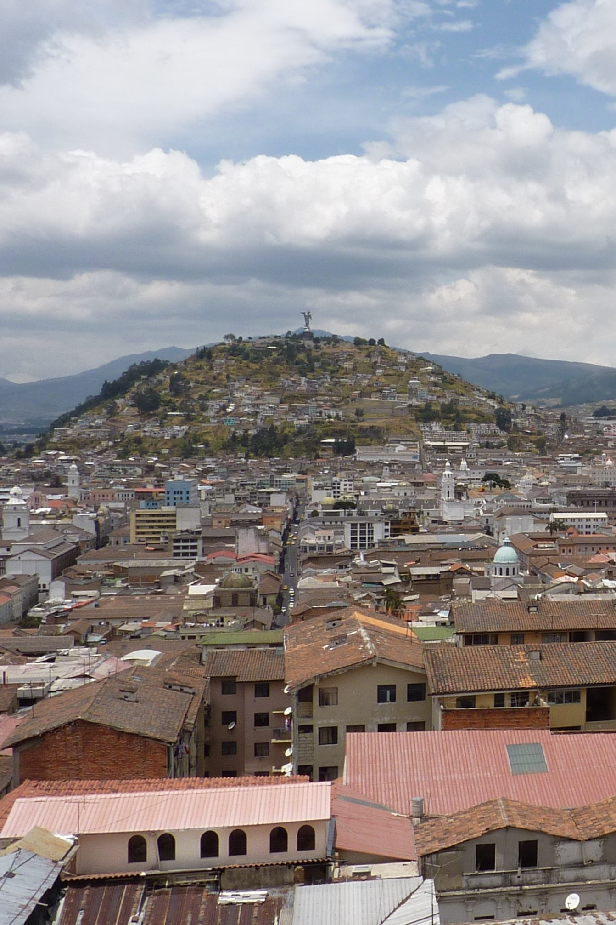
Bristol Poverty Institute (BPI): Introduction
Designed to address SDG1: End poverty in all its forms everywhere
Growing, developing and supporting the poverty and poverty-relevant research community at the University of Bristol and beyond
Facilitating interdisciplinary approaches and exploring the interface of different social, political and environmental dimensions
Translating research into evidence-informed policy and practice
More information on the BPI website.
bristol.ac.uk/poverty-institute
@bristolpoverty

Slide 4

Speakers
Professor David Gordon, Professor of Social Justice and Director of the Bristol Poverty Institute
Dr Cynthia Fonta, PhD Researcher in Social Policy Studies
Dr Sam Williamson, Senior Lecturer in Electrical and Electronic Engineering
bristol.ac.uk/poverty-institute
@bristolpoverty

Slide 5

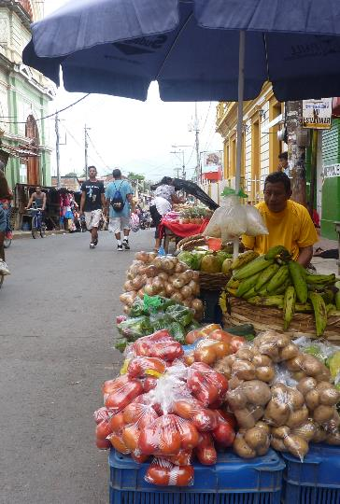



BPI contact information
Bristol Poverty Institute
University of Bristol
Bristol Poverty Institute
University of Bristol
bristol.ac.uk/poverty-institute
bristol-poverty-institute@bristol.ac.uk
@bristolpoverty

Slide 6
Bristol Poverty Institute
University of Bristol
bristol.ac.uk/poverty-institute
@bristolpoverty

